Slide 1
WordMush
By Sam Bodanis

Slide 2
What does it do?
Generate original poems in the styles of famous poets
Uses Markov models to ensure every you never see the same poem twice
Social integration, share your favorite poems on Facebook
‘Mush’ feature – create a Markov model of a mixture of two poets’ styles

Slide 3
Design Decisions
Built in iOS
iOS users are more likely to pay money for an app
More unified platforms
Most iOS users are on the most recent OS version
Limited Devices

Slide 4
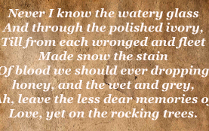
An Example Poem – a combination of Oscar Wilde and Robert Burns

Slide 5
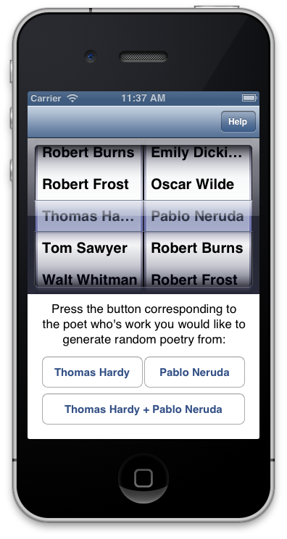
Main Page
Scroll pickers to select poets
Press buttons corresponding to one poet to generate random text from that poet’s works
Press the combination button to generate random text from a mixture of their works.
Get Help

Slide 6
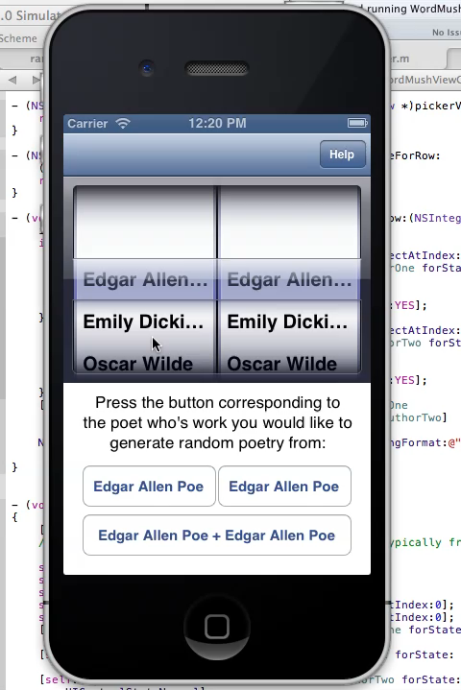
Example Run

Slide 7
What to do next
Pretty up the UI
Implement iAds, make some $$$
Submit to iOS app store, paid and free (with ads) versions.
Perhaps in app purchases for access to more poets

Slide 8
Any Questions?

